Slide 1

Stroke prediction using machine learning
Instructor: PhD. Hoang Quang Huy
PhD. Tran Anh Vu
Team 22:
Đào Công Khôi – 202414847
Phạm Minh Dũng – 202414833
Nguyễn Chu Hiếu - 202414837

Slide 2
1. Defining problem (1)
STROKE
Stroke is a medical emergency that happens when blood flow to the part of the brain is blocked or the blood vessel in the brain bursts, causing death in brain cells.
There are 3 main types:
  Ischemic: the most common type. It occurs when a blood clot blocks a blood vessel, stopping blood flow to the brain.
  Hemorrhagic: This happens when a blood vessel in the brain leaks or ruptures, causing bleeding. The blood puts pressure on the brain and damages cells.
  Transient ischemic: temporary blockage of blood flow.

Slide 3
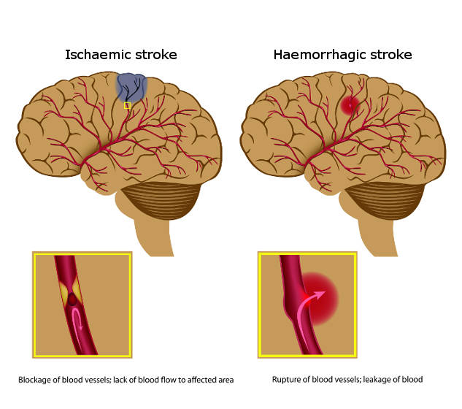
1. Defining problem (1)
STROKE DAMAGE
Stroke can:
  Cut blood flow to certain parts of the brain.
  Cause bleeding, pressure on cells and irritation.
Effects:
  Physical disabilities
  Communication deficits
  Cognitive and emotional changes

Slide 4
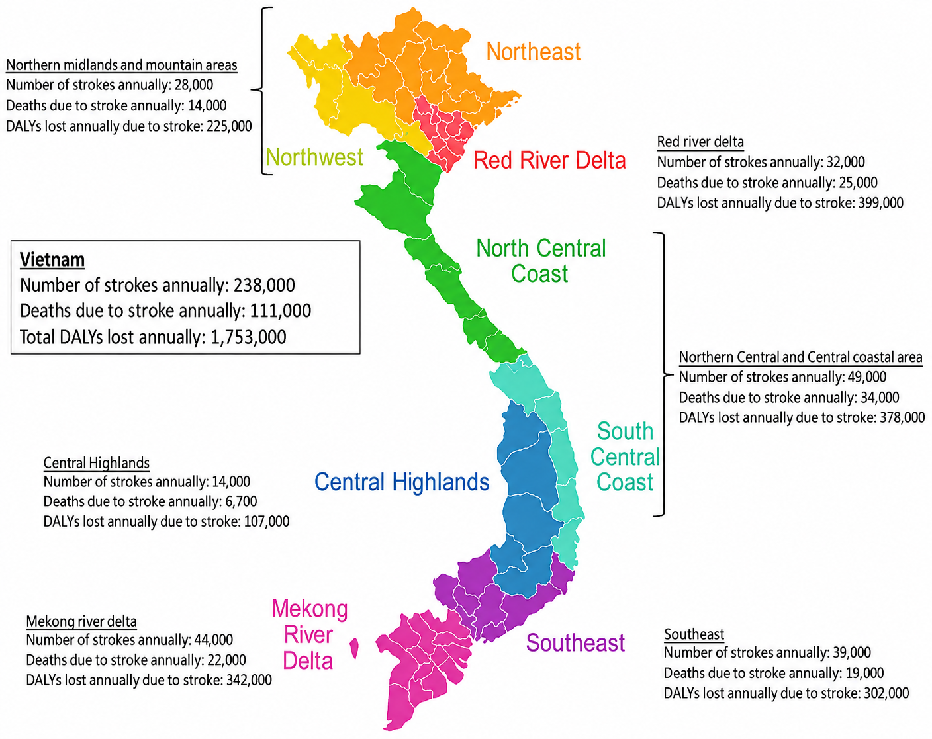
1. Defining problem (1)
STROKE IN VIETNAM
200,000 new cases on average annually.
222 people experience a stroke out of 100,000
170 deaths out of 100,000 people.
Men face a roughly 58% higher mortality rate.
Median age range:
  Men: 60-64
  Women: 65-69

Slide 5
1. Defining problem (1)
STROKE SYMPTOMS
Balance loss, vision changes
Face drooping, body weakness
Severe headache, speech difficulties
→ Symptoms can be subtle and hard to detect
→ Stroke damage can be minimized if it is detected early (nearly 2m brain cells die every minute that blood is not supplied, treatment works best under 4 hours)

Slide 6
1. Defining problem(1)
STROKE DIAGNOSIS
Risk calculator: using algorithms to estimate the probability of stroke over a period of time
>> Might miss sudden changes leading to stroke
Ultrasound and scan: mapping physical blockage and structural issues
>> Invasive risk and may miss microvascular issues
Functional assessment: identifying hypertension, diabetes,…

Slide 7
1. Defining problem(1)
CURRENT DIFFICULTIES
Diagnosis can be pricey and time-consuming
Most cases apply only one model at a time, there has been little effort in combining them to work together
Current machine learning models can reach high accuracy but fails to address their mechanism, leading to difficulties in building trust

Slide 8
2. Solution(1)
Developing ML models to predict stroke risks accurately
Try ensemble and combining multiple models
Applying SHAP to clearly explain models mechanism and aid in data visualization

Slide 9
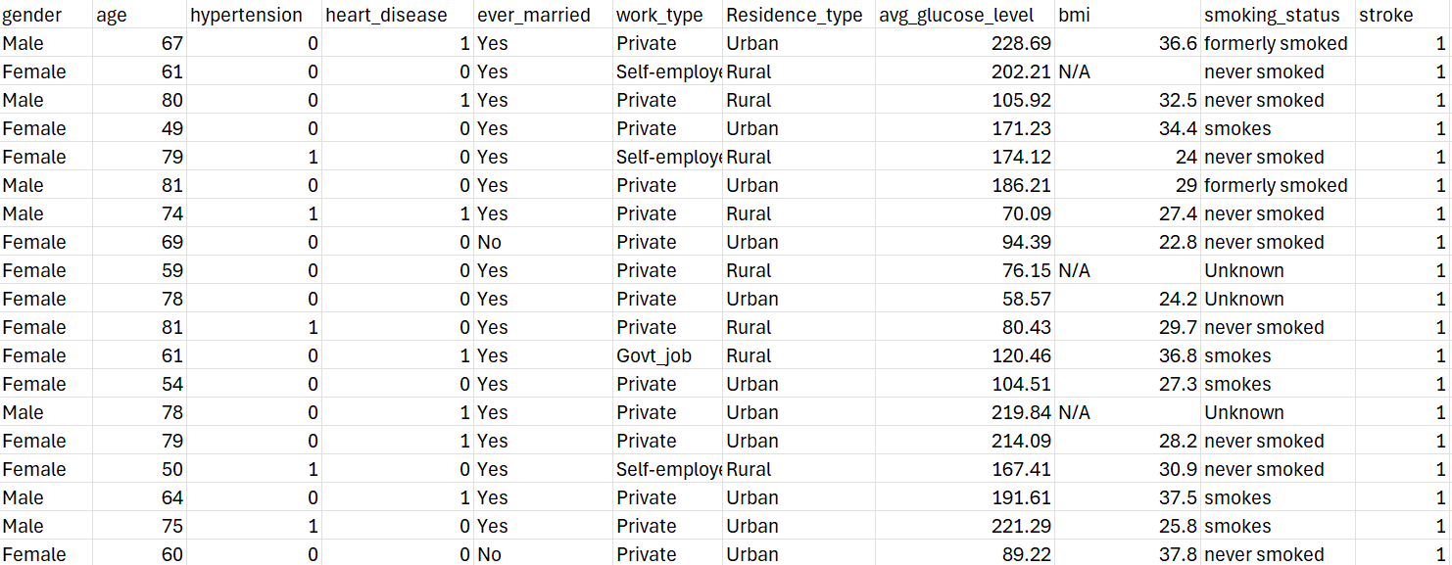
2. Solution(1)
DATASET
Link: https://www.kaggle.com/datasets/fedesoriano/stroke-prediction-dataset
This dataset contains over 5000 patients with 12 attributes

Slide 10
3. Timeline (1)
Week | Work content
1-3 | Defining problem, literature review, Database, conduct EDA
4-6 | Split patient data, separate pipeline for training data, baseline results
7-10 | Proposed model architecture, overfitting studies
11-12 | Evaluation system: sensitivity, specificity, ROC, AUC, …. XAI visual representation
13-15 | Draft paper in IEEE format, presentation

Slide 11
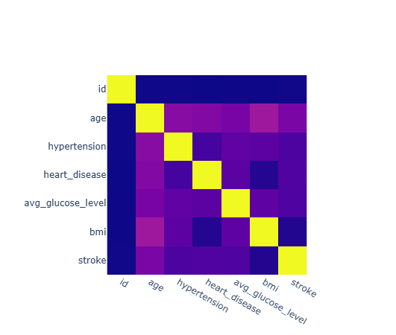
4. Data exploration
We can see that age has the highest correlation, followed by hypertension, heart diseases and glucose level

Slide 12
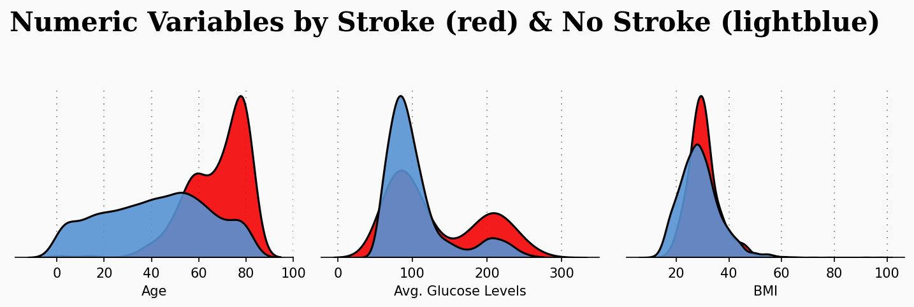
4. Data exploration
Stroke patients are generally older
Stroke patients have a more even glucose distribution
BMI also has a high correlation to stroke

Slide 13
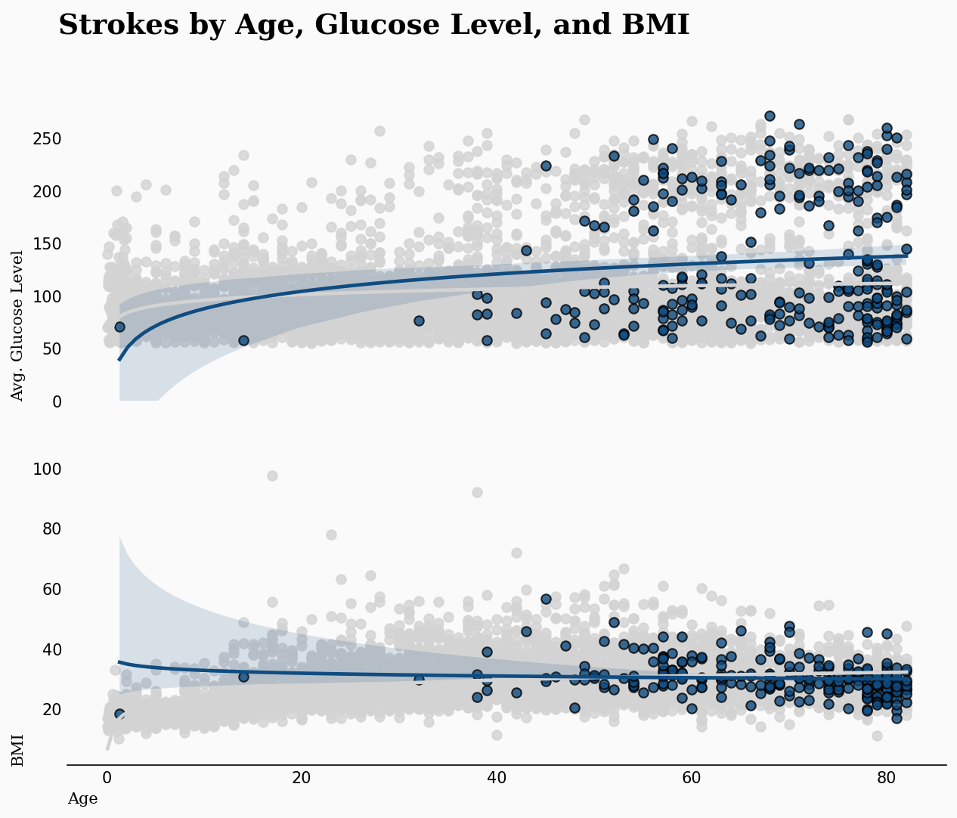
4. Data exploration
Distribution of glucose level and BMI in relative to age

Slide 14
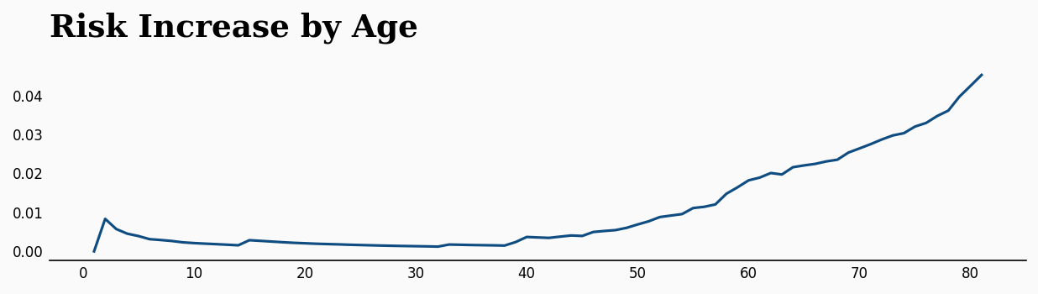
4. Data exploration
Hypothetical prediction of stroke risks relatively to age

Slide 15
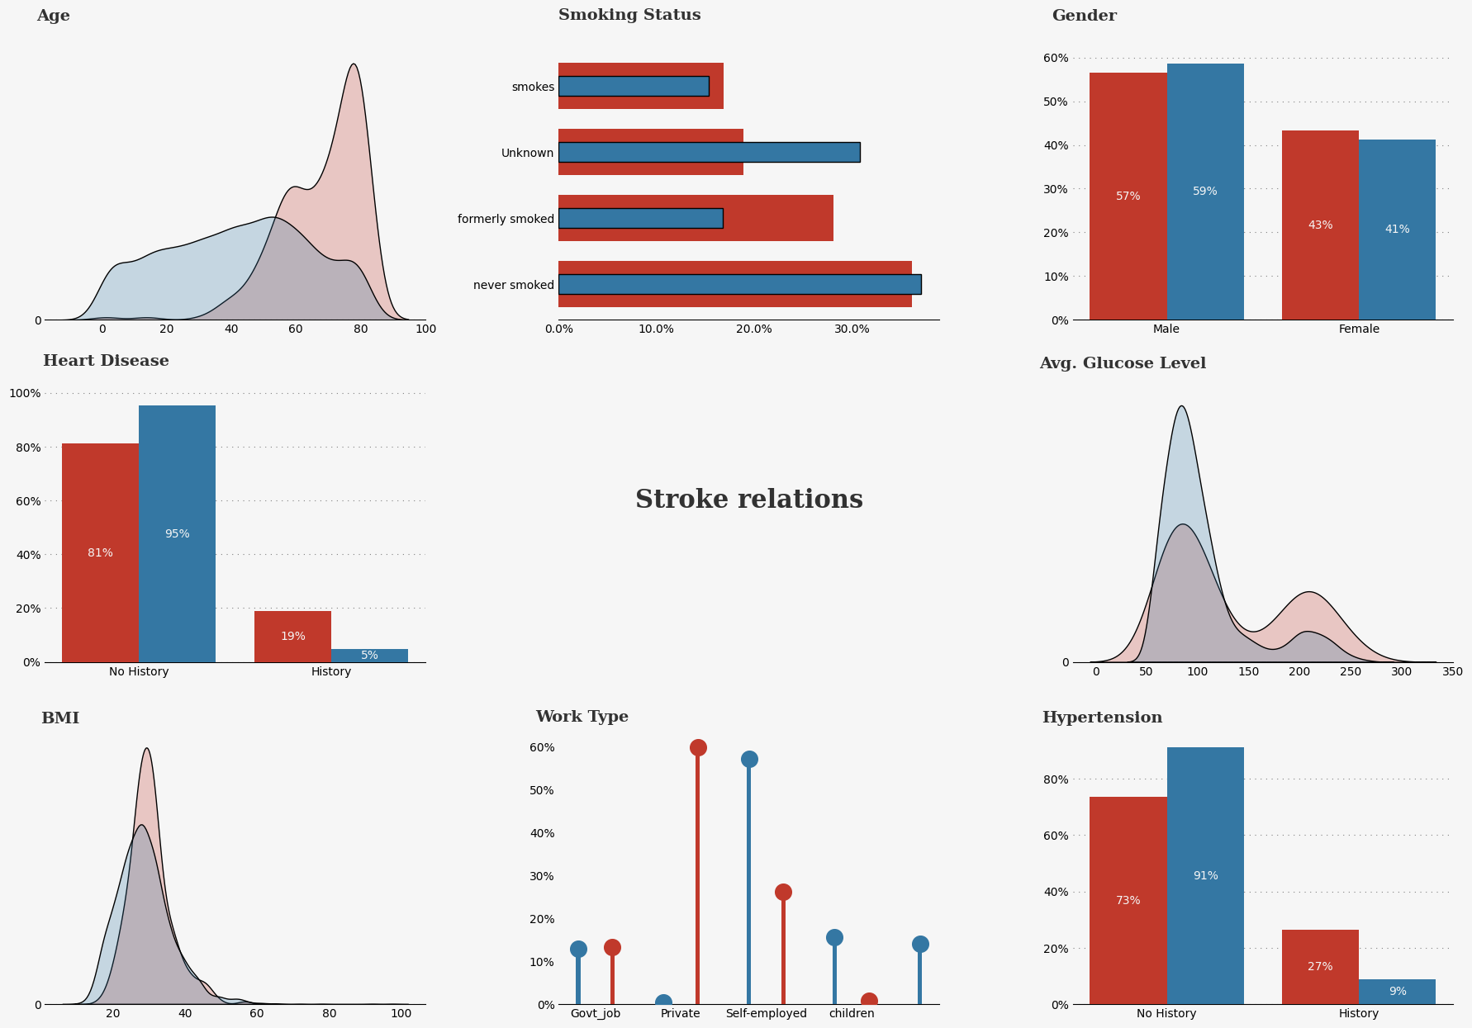
4. Data exploration

Slide 16
4. Data exploration
CONCLUSION
Age — Stroke patients skew noticeably older - density peaking around 60–80
Smoking Status — "Never smoked" and "Unknown" dominate both groups, but "formerly smoked" and "smokes" show a higher proportion among stroke patients.
Gender — Fairly similar split between groups
Heart Disease — Stroke patients have a markedly higher rate of heart disease history
Avg. Glucose Level — Stroke patients show a primary of around 100, and a secondary bump of around 200
BMI — Distributions largely overlap, with stroke patients trending slightly higher.
Work Type — most stroke patients are self-employed, while most non-stroke people are have private jobs
Hypertension — Similar pattern to heart disease: stroke patients have a much higher rate of hypertension history

Slide 17
4. Data preprocessing
Encoding text categories into small integers so the ML model can use them (strings >> numbers)
Examining data: 4861 non-stroke, 249 stroke. Therefore, we have a critical imbalance present in the dataset
Null Accuracy = 4861/(4861+249) = 0.95; Inverse of Null accuracy: 249/(249+4861) = 0.05
Splitting train-test dataset by 80/20, using SMOTE to generate synthetic examples of the minority class (stroke cases) in the training set only, so the model sees a more balanced mix of stroke/no-stroke examples during training

Slide 18
4. Data preprocessing
Encoding text categories into small integers so the ML model can use them (strings >> numbers)
Examining data: 4861 non-stroke, 249 stroke. Therefore, we have a critical imbalance present in the dataset
Null Accuracy = 4861/(4861+249) = 0.95; Inverse of Null accuracy: 249/(249+4861) = 0.05
Splitting train-test dataset by 80/20, using SMOTE to generate synthetic examples of the minority class (stroke cases) in the training set only, so the model sees a more balanced mix of stroke/no-stroke examples during training

Slide 19
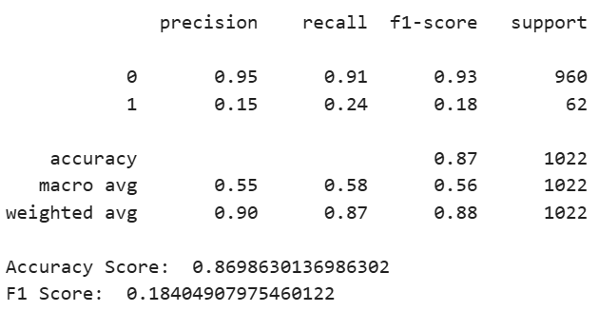
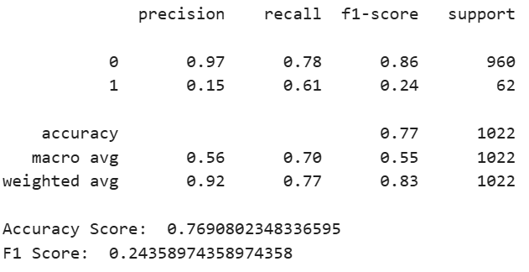
5. Preparing models
We attempt to try Logistic Regression, Random Forest and SVM
Based solely on accuracy, we have:
  RF: 86.7%
  SVM mean: 79.2%
  LR mean: 76.9%
When testing on data, we have:
RF: High accuracy, poor recall
LR: Lower accuracy, better recall

Slide 20
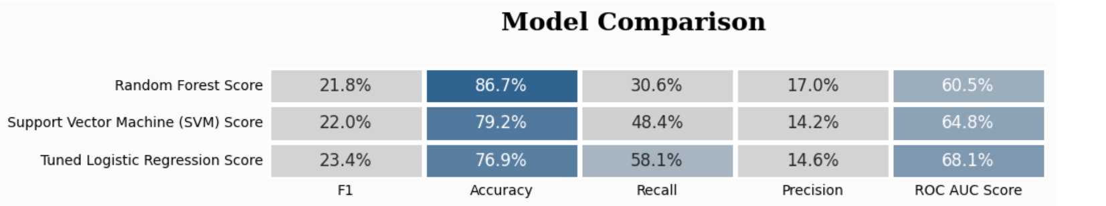
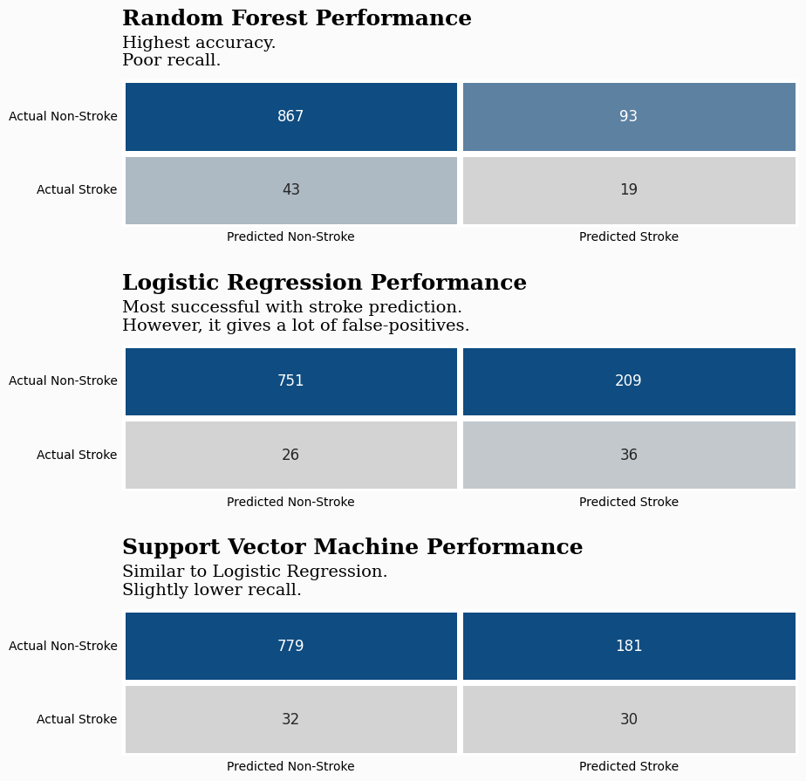
5. Preparing models
Here we provide a comparison between the 3 models
Highest accuracy, poor recall
Better recall, high positives
Similar to LR, lower recall

Slide 21
5. Preparing models
So we use Stacking Classifier, which:
Combines Logistic Regression, Random Forest, and XG Boost as base models.
Uses another Logistic Regression model as the meta-model to combine their predictions.
Aims to improve predictive performance by leveraging the strengths of different models.

Slide 22
5. Preparing models
SHAP
Produces summary plots to examine the importance of features.
Uses dependence plots to investigate the relationships between features such as age and BMI and the model's predictions.
LIME
Explains an individual prediction.
Helps identify which features contributed to the model's prediction for a selected case.
These methods help make the model's decisions easier to understand, although they do not establish causal relationships between features and stroke.

Slide 23
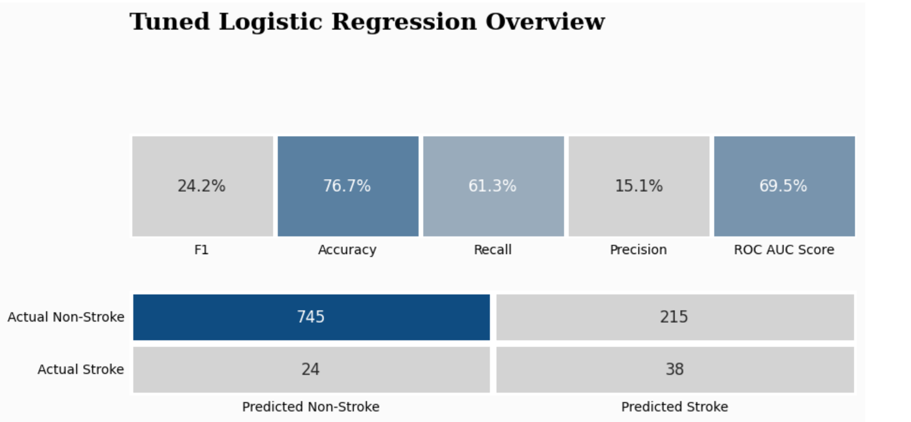
5. Preparing models
After careful consideration, we decided to choose the tuned Logistic Regression model
This model has a slightly lower accuracy but makes it up with a much higher recall

Slide 24
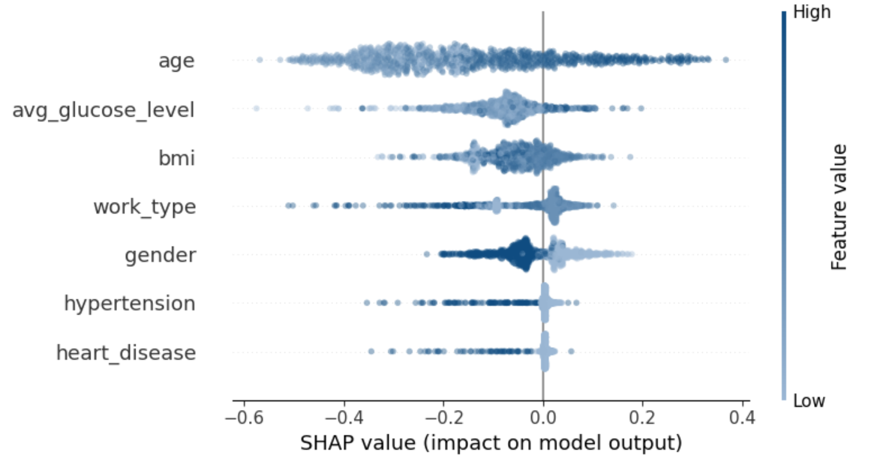
6. SHAP integration
Shapley Additive Explanation: a technique that breaks down a prediction to show the impact of each feature
The graph shows the effect of each data dot
The color shows whether the value is high or low
Ex: the top left point of age reduce the prediction by 0.6

Slide 25
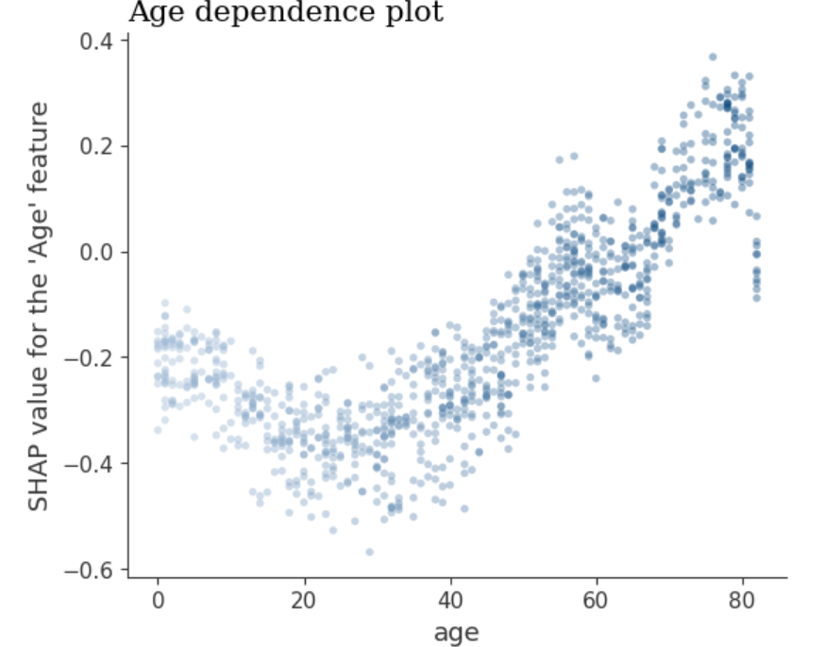
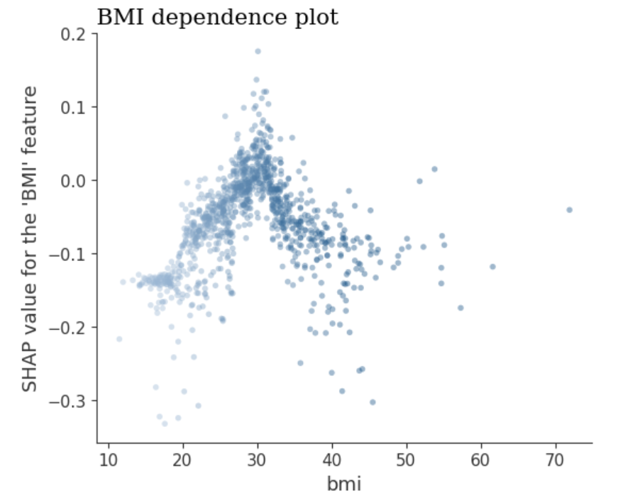
6. SHAP integration
We can also use SHAP to create dependence plots
Higher impact when age > 45
Higher impact when bmi > 30

Slide 26
THANK YOU !

